Slide 1
Lecture: Thinking the insurrection
Speaker:
Clayton Crockett (Professor, University of Central Arkansas) Jeffrey W. Robbin(Asistant professor, Lebanon Valley College)
Chair: Professor Wang Xingfu
Time:3.00-6.00 p.m, May 8, 2017
LocationGuanghua Building West Tower 2604
The Center of Contemporary Marxist Studies abroad
Fudan University

Slide 2
Thinking the insurrection
Crockett and Robbins Studied Postmodern Philosophy and Religion at Syracuse University
In the wake of the events of 9/11/2001, we both engaged more explicitly with Political Philosophy and Political Theology
In 2006, we started a book series with Columbia University Press, along with Slavoj Zizek and Creston Davis
The series is called “INSURRECTIONS: CRITICAL STUDIES IN RELIGION, POLITICS, AND CULTURE”

Slide 3
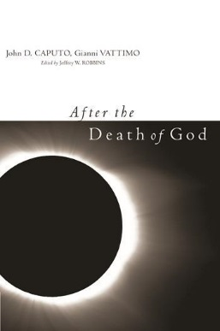

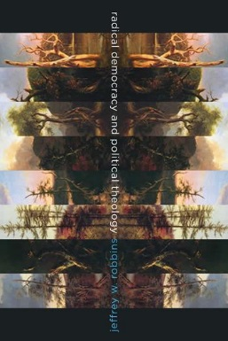
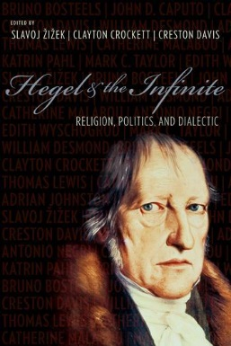
Thinking the insurrection
From 2007 to 2017, we have published 40 books in the Series:

Slide 4
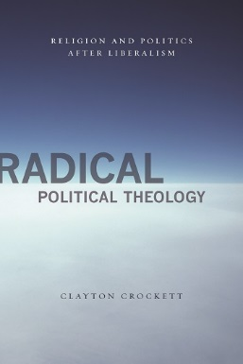
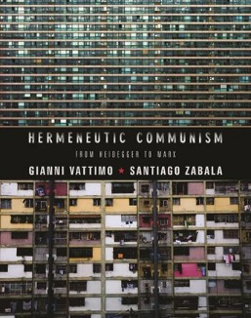

Thinking the insurrection

Slide 5
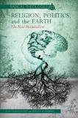
Thinking the insurrection
In 2012, Crockett and Robbins published RELIGION, POLITICS, AND THE EARTH: THE NEW MATERIALISM with Palgrave Macmillan
This book was the first book to connect the philosophy of New Materialism to Religion

Slide 6
Thinking the insurrection
Religion, Politics, and the Earth sketches out a broad post-Capitalist vision, with chapters on Digital Culture, Religion, Politics, Art, Ethics, Energy, Being, and Logic
At the heart of the book is an Ontology of Being as Energy Transformation
The Philosophical Core is a synthesis of Hegel and Deleuze: We apply Hegel’s notion of “Substance Becoming Subject” from the Phenomenology of Spirit to the Concept of Earth. This perspective on Earth is then combined with Deleuze and Guattari’s Geology of Morals from A Thousand Plateaus: “Who Does the Earth Think it is?”

Slide 7
Thinking the insurrection
We need to think with and from the Earth, in light of the Anthropocene, Global Warming, and Resource Depletion
Capitalism is based on a logic of infinite growth, which is impossible given a finite planet
We need a deep thinking of Earth, without simply romanticizing it, that opposes the superficial elements of globalization and contemporary neo-liberalism
Energy is thoroughly physical/material, and it is spiritual at the same time, in immanent terms. Energy flow through a system organizes that system.

Slide 8
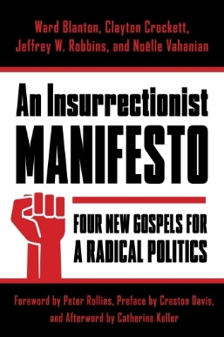
Thinking the insurrection
In 2016, we published AN INSURRECTIONIST MANIFESTO: FOUR NEW GOSPELS FOR A RADICAL POLITICS, along with Ward Blanton and Noëlle Vahanian.
This book develops an Insurrectionist Philosophy and Theology to go along with our book series and our co-authored book.

Slide 9
Thinking the insurrection
This book contrasts Social and Political Insurrection with Individualist obsessions focused on personal Resurrection
The solitary Ego is the focus of salvation-based Religions, as well as consumerist corporate Capitalism, that views fulfillment in terms of buying and consuming products and experiences
Capitalism is running up against real physical limits, and as a result more and more wealth is being transferred to fewer and fewer people
Insurrection is not just a reactionary movement against something else; it is a “surrection-in-process, a surging-in that unfurls and surges forth, and it is this vital affirmation that must characterize insurrection and insurrectionary thought.”

Slide 10
Thinking the insurrection
In the Introduction, we lay out five elements of insurrectionist thinking:
1) A filiation with the traditions of radical and political theology, which includes a never-ending reflection on the many and multiple “deaths of God” and deconstructions of sovereignty of the inherited traditions.
2) An ontology of the Real that is for us linked to the theorization of Jacques Lacan and Gilles Deleuze as well as elaborated by Slavoj Zizek and Franҫois Laruelle.
3) A dynamic materialism that affirms material reality in non-reductive ways, recognizing the valencing effect of ideas which must still be called “vital”. This materialism would be a plastic materialism, following Catherine Malabou.
4) A commitment to a leftist political edge which nevertheless eludes dogmatic certainty—ours is the struggle with and within the world for an ethical-ecological vision of Life beyond money, greed, power and devastation of neoliberalism and corporate capitalism.
5) An experimental thinking in which everything is up in the air, staked and at stake, a politico-philosophical-theological laboratory formulating new tests for a theory that is always en procès (in process/on trial, to use a term from Julia Kristeva).

Slide 11
Thinking the insurrection
In the main body of the book, each of the authors offers an insurrectionary ‘gospel,’ the Good News of a crucial part of our reality.
These four gospels take their topics and titles from what Martin Heidegger calls the “Fourfold,” borrowing this mythological description from the poet Friedrich Hölderlin.
For Heidegger, the Fourfold are Earth and Sky, Gods and Mortals. These are poetic elements for a thinking of Being that allows Dasein to dwell in the Open region of its ownmost potentiality in a pose of Gelassenheit (letting go), where there is the chance of the Event (Ereignis). We take our cue from Heidegger, but we are not faithful to his philosophy.

Slide 12
Thinking the insurrection
In Part One—”Earth: What Can a Planet Do?,” Crockett elaborates a vision of Earth in terms of energy flows, non-equilibrium thermodynamics, and the philosophy of Deleuze and Deleuze and Guattari.
For D&G, in A Thousand Plateaus, Earth in itself represents an absolute deterritorialization and the thinking of a smooth space that is not yet segmented into strata, which is a Mechanosphere, or Body-Without-Organs (BwO). We need a new Nomos of the Earth that encompasses the Assemblages at once machinic and organic, molar and molecular, to renew our thinking and our living.

Slide 13
Thinking the insurrection
In Part Two—”Satellite Skies; or, The Gospel and Acts of the Vampirisms of Transcendence,” Blanton critiques Heidegger’s romantic thinking of Sky and contrasts it with our colonization of the skies.
On the one hand, our satellites, our technology, our modes of thought siphon off our energies into a vacuous transcendence; but on the other hand, they allow us to imagine new possibilities. “We need to prepare ourselves for the writing of a new emigration of outsiders ready to found, once more, a people from the resonance they intuit in the regularized Skies and errant satellite stars under which they stand.”
Blanton affirms a wild archivist mentality that collects ancient sources in order to blow them apart, releasing new energies for our renewal and transformation.

Slide 14
Thinking the insurrection
In Part Three—”Beyond the Way of the Mortals”, Robbins develops a theory of insurrection based on two main sources:
  1) Catherine Malabou’s concept of plasticity – specifically, the notion of a metabolic ontology and how resistance is built into the order of nature;
  2) Antonio Negri’s “ontology of the ruination of the law of measure”—specifically, a political ontology built on the biblical character of Job as a figure of liberation.
Robbins ultimately argues that human beings have the capacity to resist the way of mortality, which he defines as the temptation “to eat or be eaten; or consume or be consumed.”

Slide 15
Thinking the insurrection
In Part Four—”Insurrection from Within the Heart of Divinity”, Vahanian offers a critical and deconstructive reading of the Heideggerian fourfold by considering the violent normalcy of human civilization, with special appeal to critical race studies, the conquest of the Americas, and genocide studies.
Vahanian ultimately argues that liberation must come from below, that it is a fundamentally human problem, and that we must find a way to conceive of change without exoticism.

